Slide 1



SPREADSHEET: ZOMATO RESTAURANTS EXPANSION
NAME- Kumar Abhishek Rana
Date: 01 August-2024

Slide 2

Introduction & Objectives :
Founders: Deepinder Goyal and Pankaj Chaddah
Began as Foodiebay and rebranded to Zomato in 2008
Founded by IIT Delhi alumni Deepinder Goyal and Pankaj Chaddah
Headquartered in [Location]
Operates in 16 countries: India, UAE, UK, Brazil, Canada, Australia, Turkey, Poland, New Zealand, and more
Presence extends to over 40 countries through various partnerships
Mission:
Expansion: Growing global presence and opening new dining experiences
Discovery: Helping people find exceptional restaurants and dining spots
Experience: Building remarkable dining experiences with comprehensive information and recommendations
Trends: Understanding and adapting to market trends to enhance service offerings

Slide 3
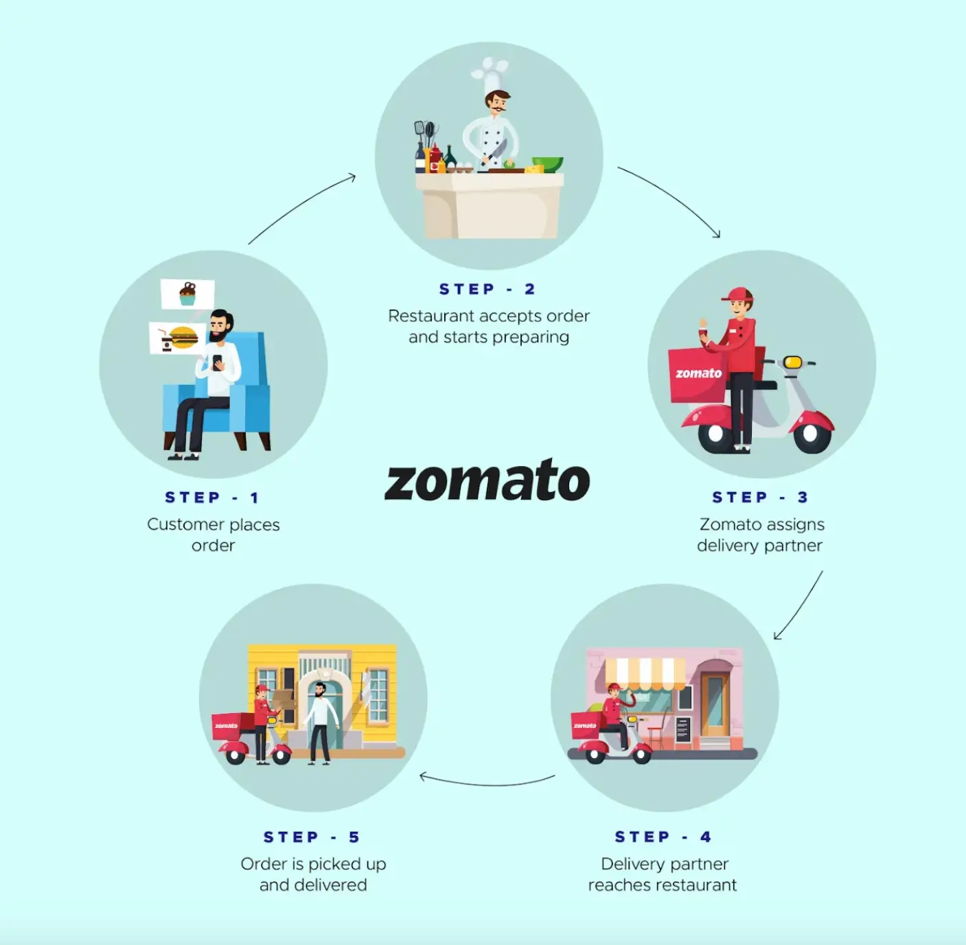
Zomato Business Model

Slide 4
Data Overview :
Restaurant ID: Unique identifier for each restaurant.
Restaurant Name: The name of the restaurant.
CountryCode: Country code of the location where the restaurant is situated.
Country:Total 16 countrys is fetch from given sheet.
City: The city where the restaurant is located.
Address: The specific address of the restaurant.
Locality: The locality or neighborhood where the restaurant is situated.
Locality Verbose: Detailed information about the locality.
Longitude: The geographical longitude coordinate of the restaurant.
Latitude: The geographical latitude coordinate of the restaurant.
Cuisines: The type of cuisine offered by the restaurant. 9 missing value is deleted by me.
Currency: The currency used for transactions in the restaurant.
Has_Table_booking: Indicates whether the restaurant has a table booking option (Yes/No).
Has_Online_delivery: Indicates whether the restaurant offers online delivery (Yes/No).
Is_delivering_now: Indicates whether the restaurant is currently delivering (Yes/No).
Switch_to_order_menu: Indicates whether users can switch to the order menu (Yes/No).
Price_range: A numeric value indicating the price range category of the restaurant.
Votes: The number of votes or ratings/(feedback) received by the restaurant.
Average_Cost_for_two: The average cost for two people dining at the restaurant.Convert in INR all.
Rating: The overall rating of the restaurant is based on user reviews.
Datekey_opening: The date when the restaurant was opened.Year is displaced from date.

Slide 5
Raw data

Slide 6
Data Preprocessing :
Extracting the imp column
Cleaning the data
Formatting the table
Apply filtering
Data Cleaning: Utilized functions such as FIND and REPLACE to rectify inconsistencies and errors, and employed the Remove Duplicates feature to ensure the accuracy and uniqueness of data entries.
Acquiring Data: Augmented the existing dataset by integrating additional variables through VLOOKUP, which allowed for the cross-referencing of external data sources to enhance the depth and completeness of the information.
Descriptive Analysis: Leveraged Pivot Tables to analyze key metrics and uncover sales patterns across various regions and product categories, providing insights into performance trends and areas for improvement.
Filtering Data: Implemented SORT and FILTER functions to categorize customers based on their purchasing behavior and demographic profiles, enabling more targeted analysis and segmentation.
Visualization: Developed dynamic charts and interactive dashboards for data representation, facilitating an engaging and comprehensive exploration of data trends and insights.

Slide 7
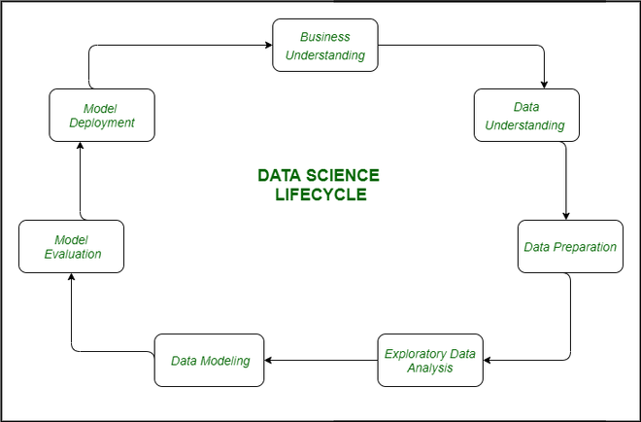
Methodology :
Analytical methods and tools used:
Using VLOOKUP to get country name with the help of country code given in 2nd sheet
Formatting is used to get INR value of avg of two cost column.
Calculating the avg cost for one in INR.
In Cuisines data set Handling missing values either by deleting or entering values.
Applying FIND and REPLACE function to get year specific.
Many visualization technique is applying to get proper charts and slicers.
Utilizing Pivot Table to get the summarized data.

Slide 8
Problem Statement
Suggesting some Countries and Cities for opening new restaurants and Expansion Strategies for ZOMATO by analyzing their datasets.

Slide 9
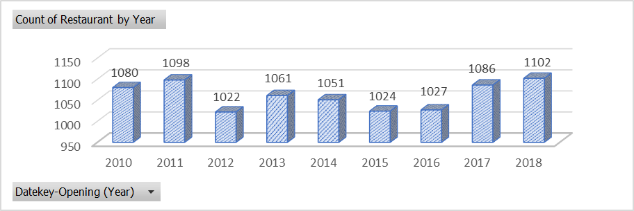
Global Overview:
The graph shows Year wise Opened Restaurant in the Zomato analytics data.
Count of Restaurant Per Year

Slide 10
Market Trends
More than 1000 restaurants opened each year.

Slide 11
Food Expenditure
We must have a balanced expenditure on food.

Slide 12
Cuisines:
Recommended Cuisines:
North Indian
Chinese
Mughlai
Fast Food
Cafe
Choice of Cuisines affects the restaurants ratings.

Slide 13
Online Table Booking & Online Delivery
Online Table Booking
Online Delivery
These additional facilities affects customer’s ratings.

Slide 14
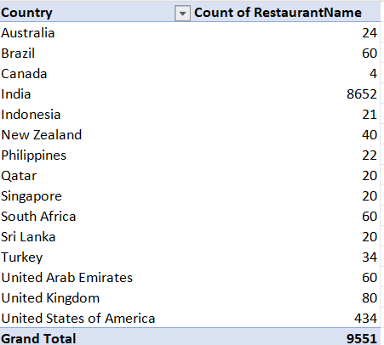
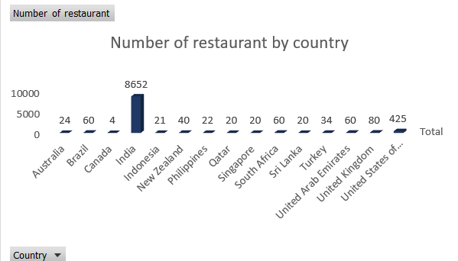
Number of restaurant present in each country
In this india has greatest number of restaurant with highest population density.
And Canada, Indonesia, Qatar, Turkey has bottom most amount of restaurant .
.

Slide 15
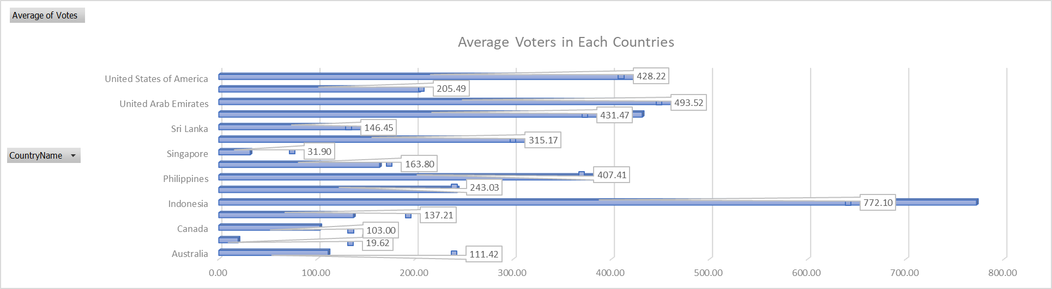
Average Voting of all country suggest that a good cuisines affect the country .
Indonesia has the highest average number of votes at 772, followed by United Arab Emirates at 494
Brazil, Singapore has the lowest average votes.

Slide 16
Expansion Opportunities:
I m selecting Seven country because of the following reasons :
COUNTRIES | Insights
Canada | Count of No. of Restaurants in Canada is lowest
Indonesia | No. of Restaurants is less and No. of votes in Indonesia is highest as compared to other which states the people in that country want new restaurants
United Arab Emirates | No. of restaurants is high but the votes are high which means peoples need more reataurants with Less Price Range.
India | Even the no. of restaurants is high but the price range is less and review are also bad so we can focus on high price range restaurants with better quality for high class peoples.
Singapore | Count is low, Review are less and price range is high, Opening new restaurants focusing on the quality and price can be beneficial.
Australia | Count are less, Review are less, Opening new restaurants focusing on the quality can be beneficial.
Srilanka | No. of restaurant is low and reviews are also not good. Focusing on quality and increasing the restaurants would be beneficial.

Slide 17
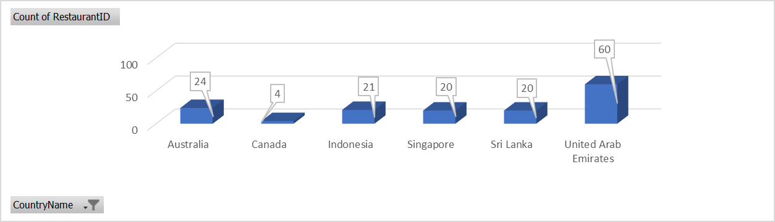
Current Scenario :
Count of Restaurant on Selected Countries

Slide 18
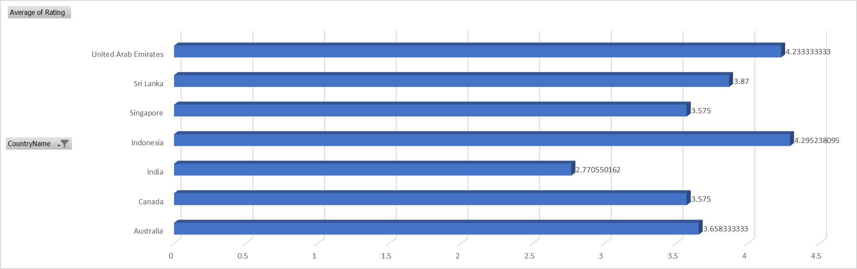
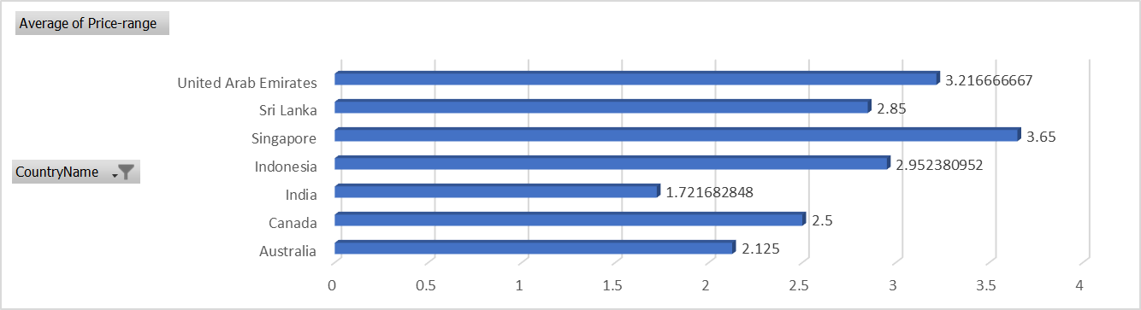
Average Ratings of Selected Countries
Average Price-Range of Selected Countries

Slide 19
Recommendations for Opening New Restaurants
Opportunity Areas with Low Restaurant Density: Analyze regions with a low number of existing restaurants but high overall ratings, indicating untapped markets with strong customer demand.
Preferred Price Range Analysis: Examine the price ranges most frequented by customers and align your restaurant’s concept and pricing strategy with these budget preferences to enhance appeal.
Cuisine and Price Range Correlation: Explore correlations between price ranges and cuisine types to understand how pricing influences the popularity of different cuisines.
Identifying Top-Rated Restaurants: Pinpoint high-rated restaurants to determine which cuisines attract the most positive attention from customers.
Focus on Budget-Friendly Options in Cost-Sensitive Areas: Analyze data to identify regions with lower average restaurant costs, and prioritize offering budget-friendly options in these cost-conscious areas.

Slide 20
More Recommendations
Cuisine Rating Trends: Evaluating the ratings of various cuisines across different restaurants nationwide to identify which cuisines receive the highest ratings.
Online Delivery Adoption Rate: Determine the proportion of restaurants offering online delivery services across the country. A high adoption rate indicates a strong consumer preference for delivery options.
Cuisine Delivery Trends: Investigate whether certain cuisines are more likely to provide online delivery services, potentially reflecting higher consumer demand for delivery of those particular cuisines.
Delivery Service Density by Region: Identify regions with a high density of restaurants offering delivery services, which may indicate a robust demand for delivery options driven by factors such as busy lifestyles or limited dining alternatives.

Slide 21
Dashboard and Visualizations :

Slide 22
Insights
Insights from Raw Data Analysis have provided Zomato with crucial information to strategically choose a new restaurant location within the country.
By analyzing Zomato’s data and market research, we can make informed decisions that will enhance the success of opening new restaurants in various cities.
This analysis gives Zomato a thorough understanding of market dynamics and customer preferences, setting the stage for a well-planned restaurant launch based on key indicators such as customer votes and ratings.
Targeting less crowded areas will enable Zomato’s new restaurant to carve out a prominent position, attract a regular customer base, and stand out in today’s tech-driven world.
Adapting the restaurant’s concept to match popular cuisine trends will ensure it resonates well with customers, boosting its appeal and success for Zomato’s new endeavor.

Slide 23
Conclusion :
In conclusion, our comprehensive market analysis has identified Indonesia, Turkey, UAE, and the UK as the top four countries that best fit our criteria for expansion.
These countries stand out due to a combination of factors: they have fewer restaurants, suggesting less market saturation, and their average costs for dining out are reasonable.
Focusing on these markets gives us a strategic advantage, allowing us to make targeted and informed decisions for our expansion.
Recommendations for Stakeholders:
Investment Strategy:
For stakeholders with lower budgets, investing in café-style restaurants is a smart move.
For those with higher budgets, opening restaurants specializing in Native or Italian cuisine is recommended.
This approach ensures that investments are aligned with both financial capabilities and market opportunities, increasing the likelihood of success in these promising locations.

Slide 24



Reference
Zomato Application software
Linkedin
Search engines
Data driven software

Slide 25

THANK YOU

